Slide 1
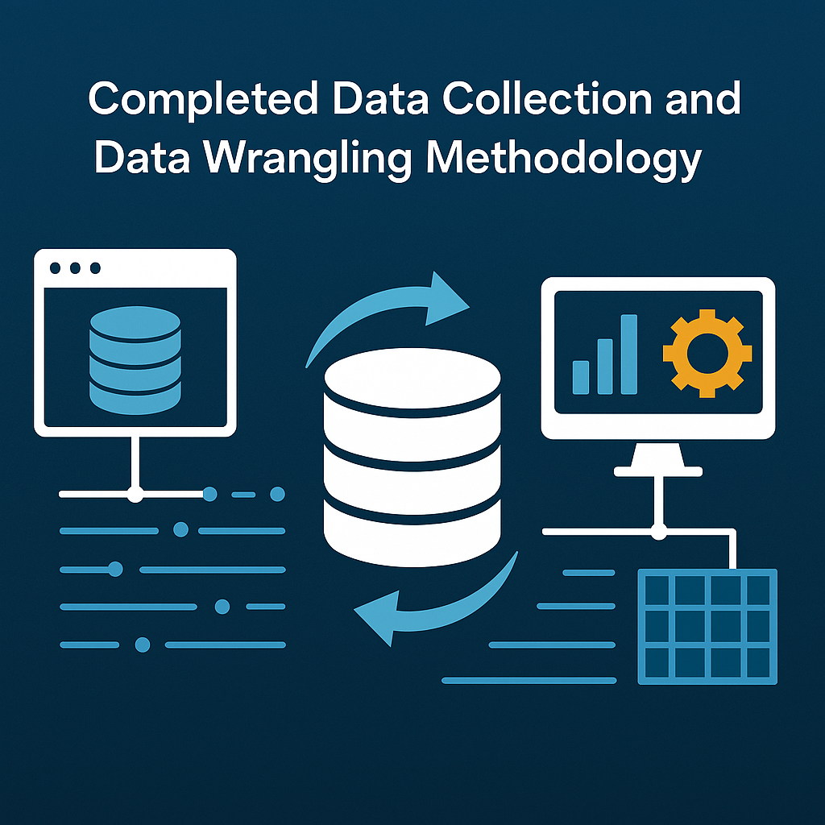

Slide 2
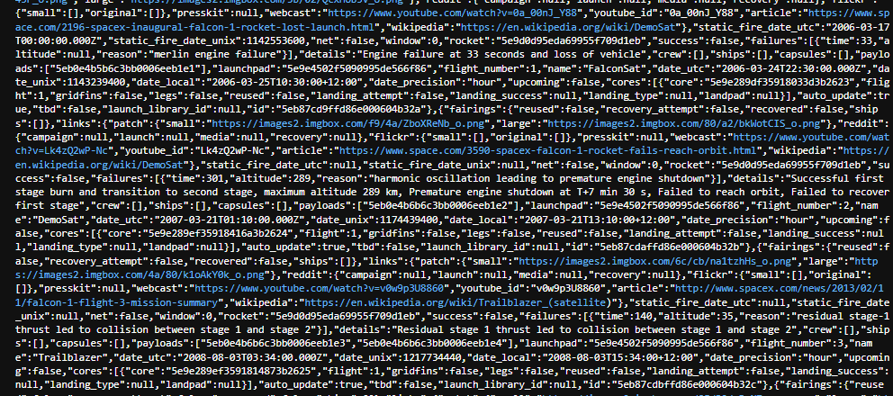
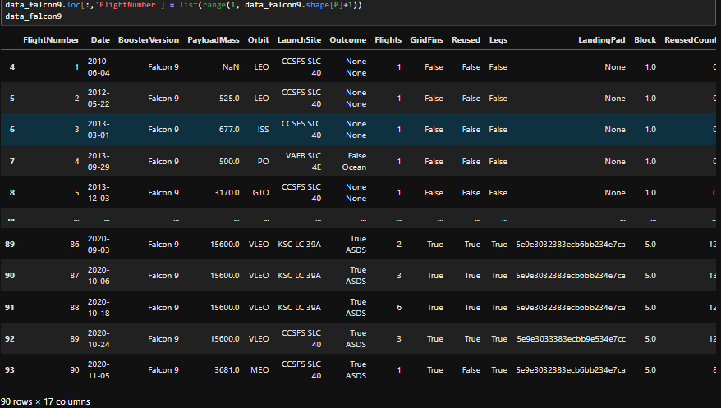
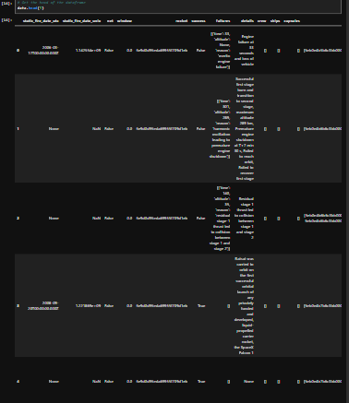

Data Collection
Sources Used:
SpaceX API (api.spacexdata.com/v4/launches/past)
Wikipedia Falcon 9 launch records (scraped using Beautiful Soup)
Data Scope:
90 launches
18 features including payload mass, booster version, orbit type, launch site, and landing outcome

Slide 3
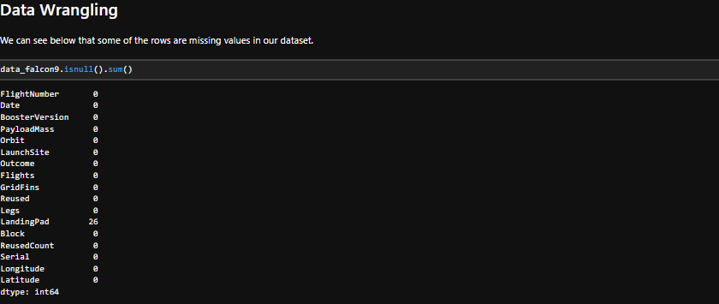
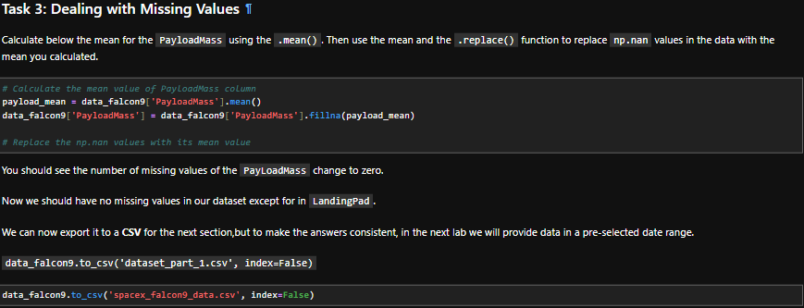
Data Wrangling Methodology
Cleaning Steps:
Removed null values and duplicates
Standardized column names and formats
Merged API and scraped data for enriched feature space
Outcome
Final dataset is clean, structured, and
ready for machine learning
All relevant features aligned with project objectives
Ensured reproducibility and modularity
for future updates

